Slide 1


MEDIC WORLD- THE PHARMACY MANAGEMENT

Slide 2
MEDIC WORLD- THE PHARMACY MANAGEMENT
INTRODUCTION
OBJECTIVE
MODULES AND SNAPSHOTS
SMAPLE CODE
OUTCOME OF THE PROJECT
CONCLUSION

Slide 3
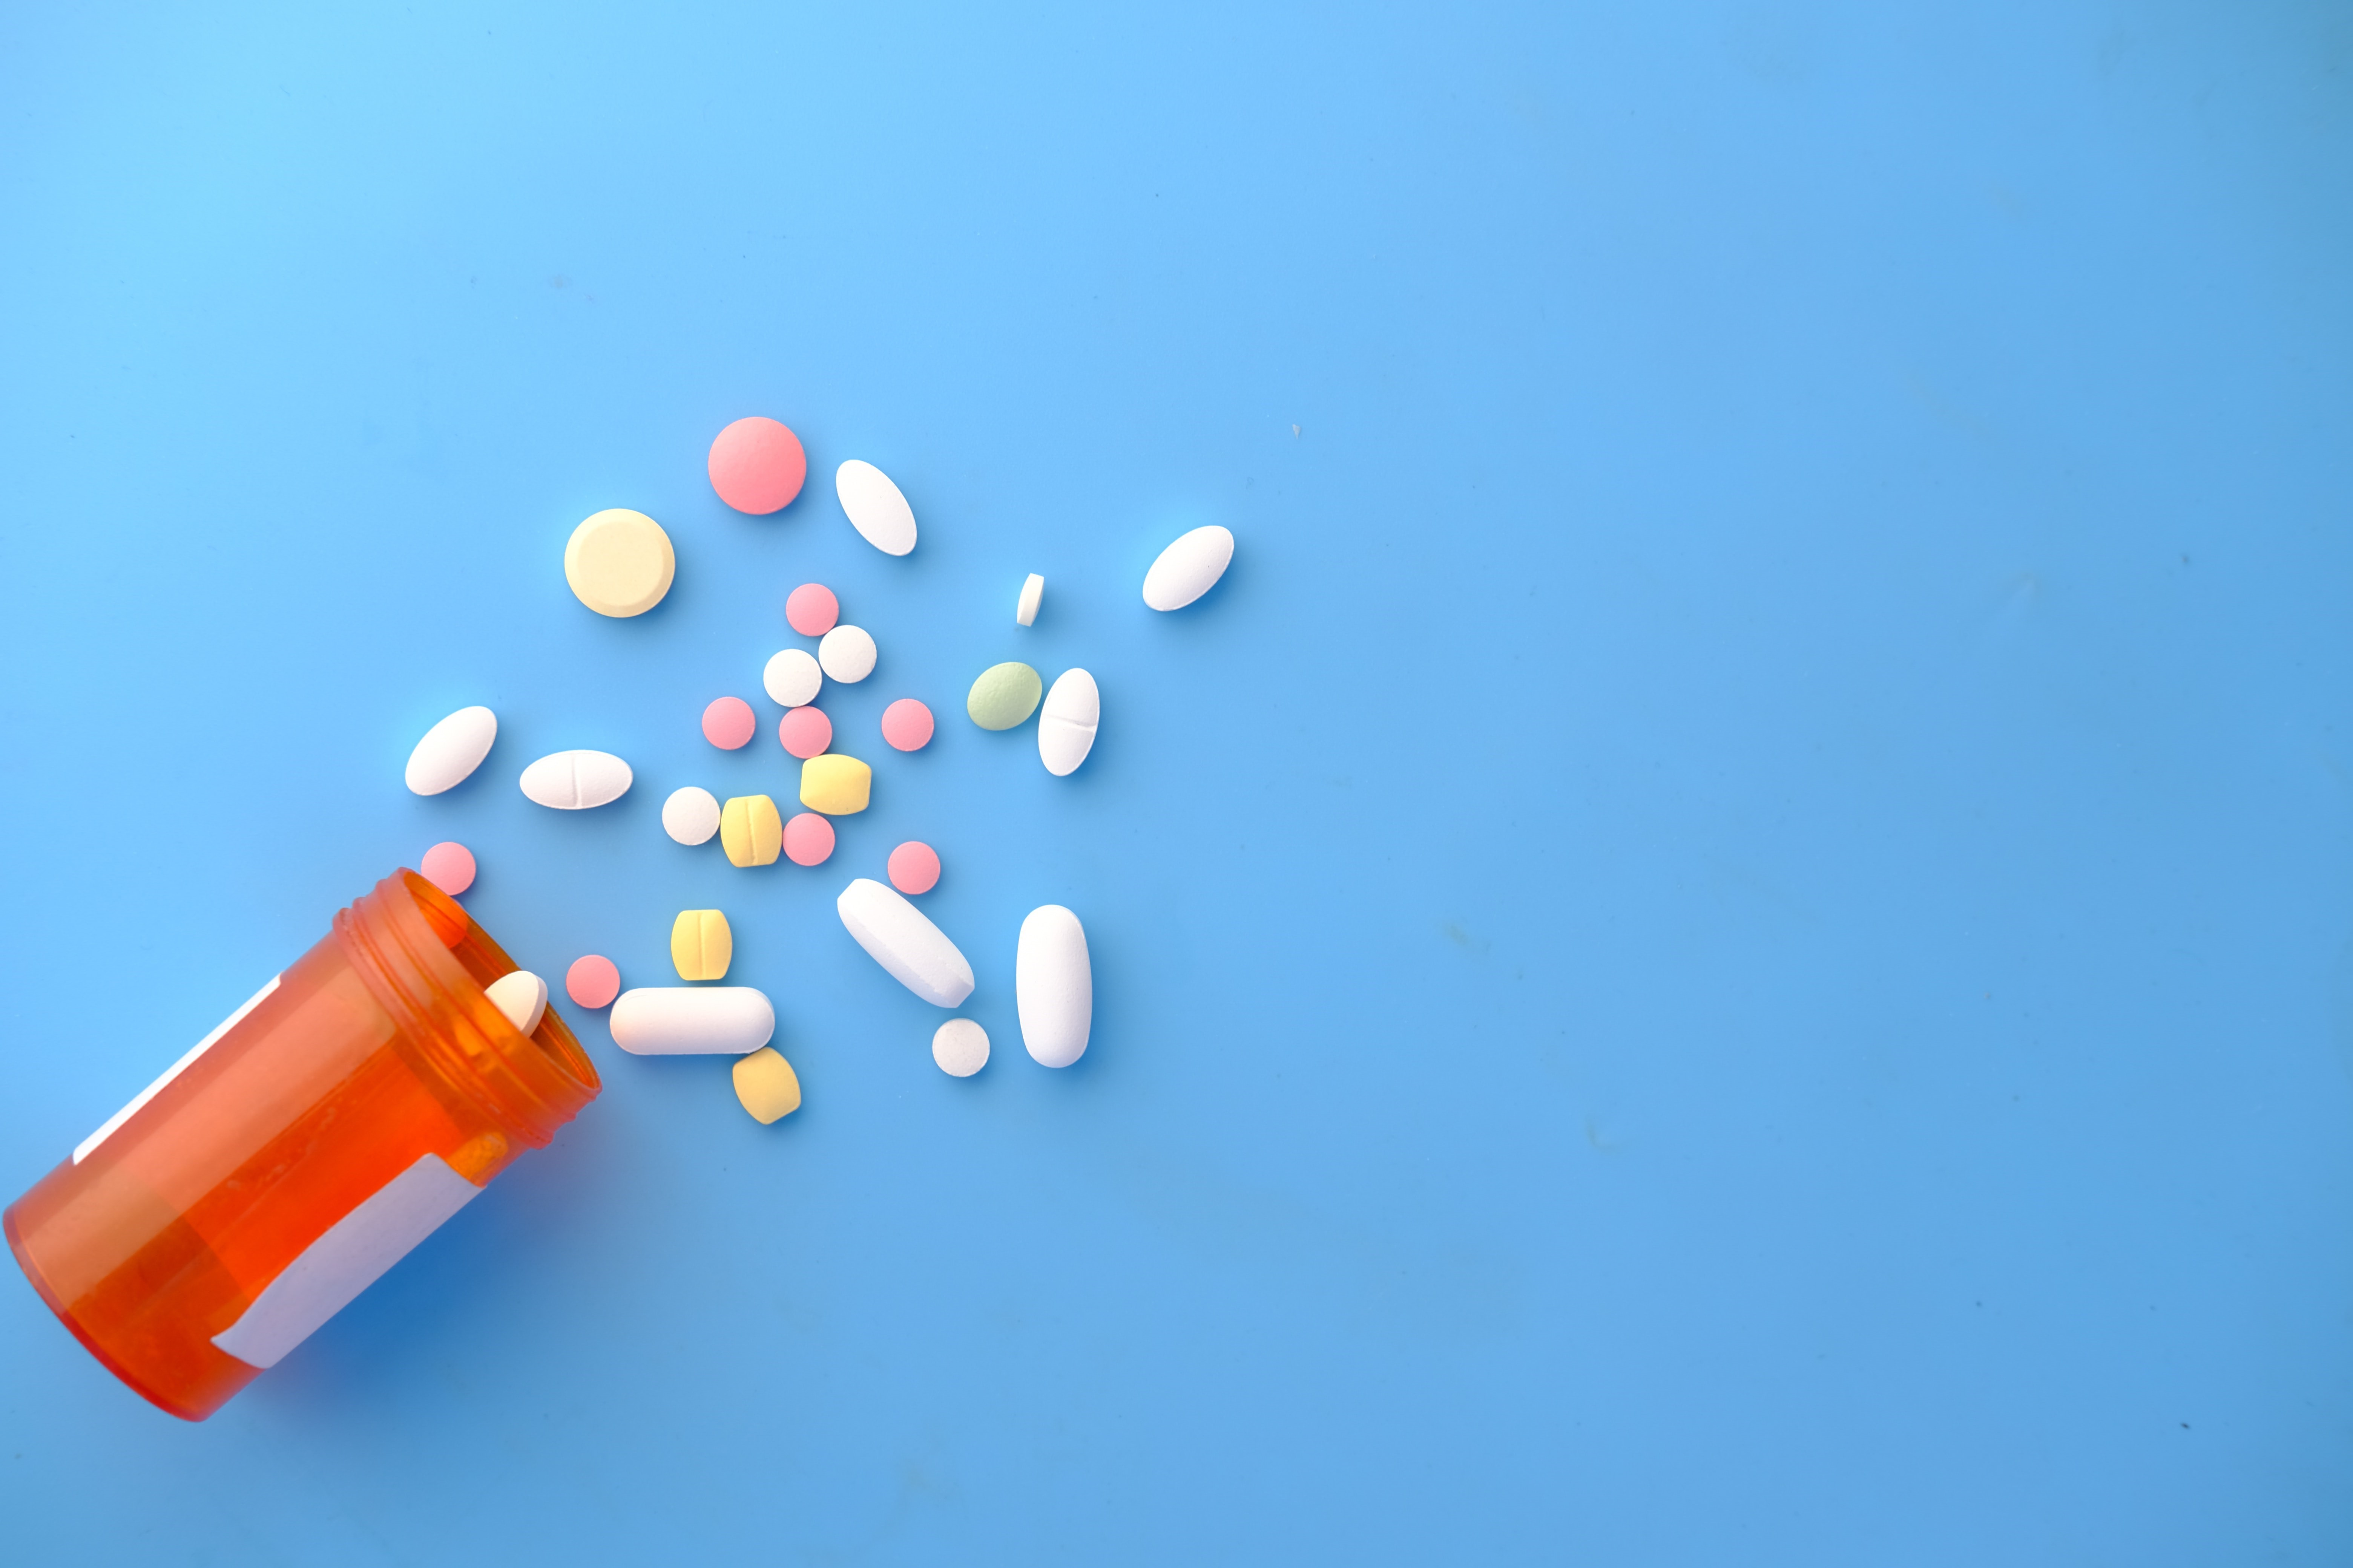
CONTENTS
INTRODUCTION
OBJECTIVE
MODULES AND SNAPSHOTS
SAMPLE CODE
OUTCOME OF THE PROJECT
CONCLUSION

Slide 4

CONTENTS
INTRODUCTION
OBJECTIVE
MODULES AND SNAPSHOTS
SAMPLE CODE
OUTCOME OF THE PROJECT
CONCLUSION

Slide 5

CONTENTS
INTRODUCTION
• A pharmacy management system is any program that performs duties including checking prescriptions and producing medications, managing inventories and placing drug orders, and dealing with billing.
• For this project, we utilized the swing library for the GUI, which has all the necessary elements like buttons, labels, separators, etc. We also used local MySQL for the database.
• There will be two different user kinds in this application: an administrator and a pharmacists. Administrators can control the information about pharmacists, and pharmacists can control stockpiles of medicine and bills.
OBJECTIVE
MODULES AND SNAPSHOTS
SAMPLE CODE
OUTCOME OF THE PROJECT
CONCLUSION

Slide 6
CONTENTS
INTRODUCTION
OBJECTIVE
The overall objective of this project is to establish a system for pharmacy shops to improve the performance and efficiency of pharmacy shops management.
Some specific objectives are:-
To provide optimal drugs inventory management by monitoring the drugs movement in the pharmacy unit.
To ensure simple customer management access.
To make printing and invoice creation for clients easily accessible.
MODULES AND SNAPSHOTS
SAMPLE CODE
OUTCOME OF THE PROJECT
CONCLUSION

Slide 7

OBJECTIVE
CONTENTS
INTRODUCTION
MODULES AND SNAPSHOTS
1. LOGIN
7. DASHBOARD (Pharmacist)
2. DASHBOARD (ADMIN)
8. ADD MEDICINE
To provide optimal drugs inventory management by monitoring the drugs movement in the pharmacy unit.
3. ADD USER
9. VIEW MEDICINE
4. PROFILE
10. UPDATE MEDICINE
To ensure simple customer management access.
To make printing and invoice creation for clients easily accessible.
11. SELL MEDICINE
5. UPDATE USER
6. VIEW USER
12. VIEW BILL
SAMPLE CODE
OUTCOME OF THE PROJECT
CONCLUSION

Slide 8
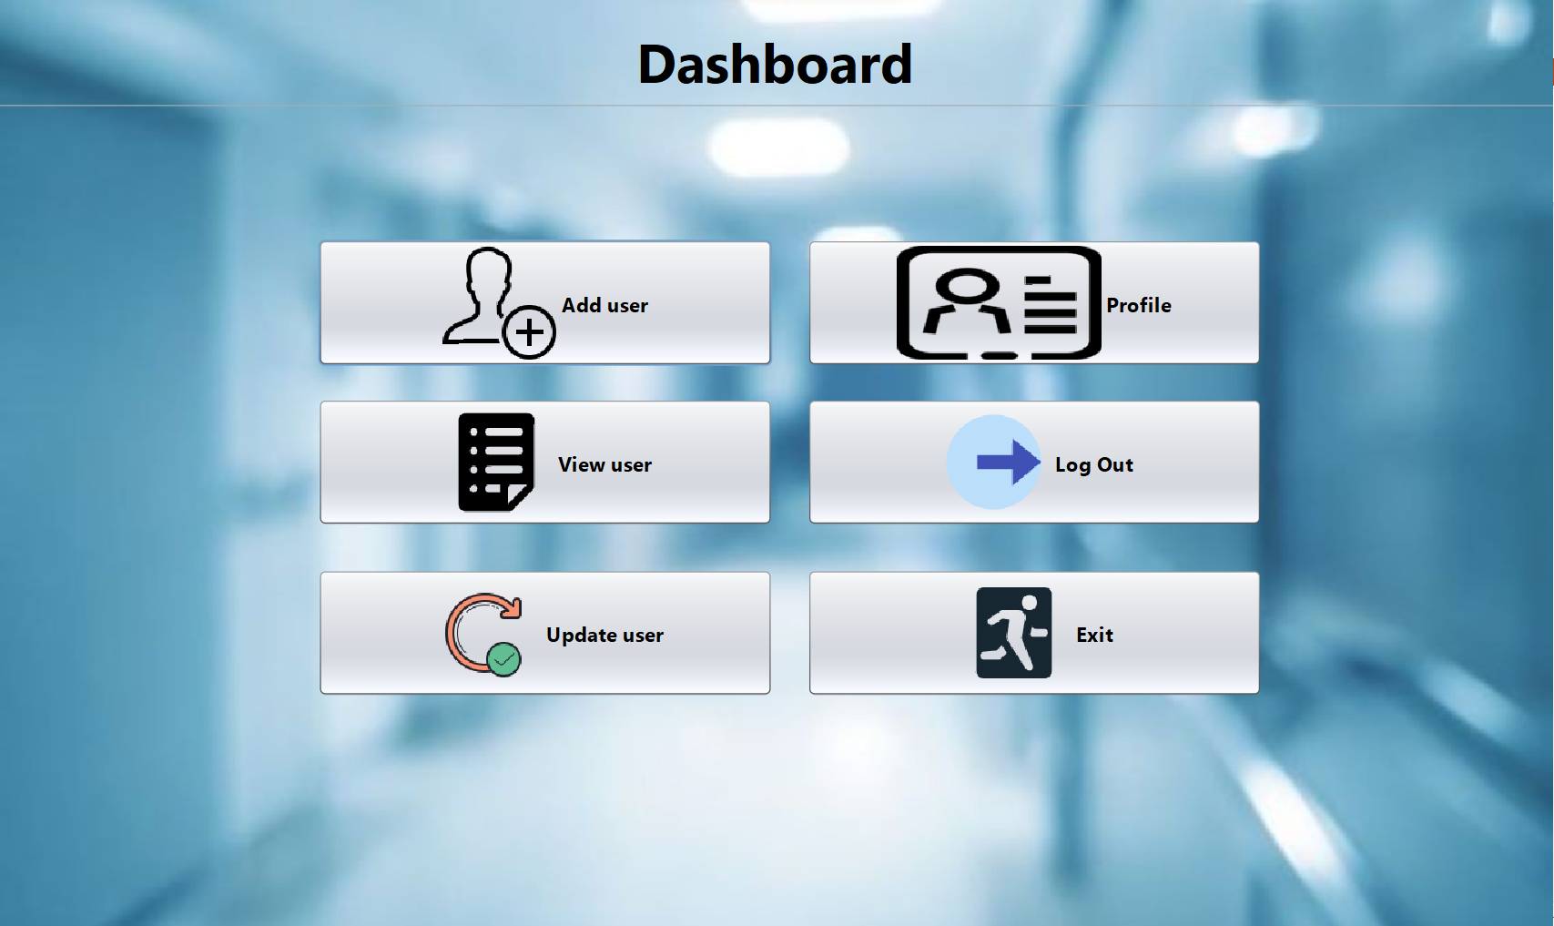
OBJECTIVE
CONTENTS
INTRODUCTION
MODULES AND SNAPSHOTS
1. LOGIN
The administrator or chemist can log in using their username and password on this page. the dashboard user interface will then be provided to them based on their user role.
To ensure simple customer management access.
To make printing and invoice creation for clients easily accessible.
2. DASHBOARD (ADMIN)
4. PROFILE
3. ADD USER
5. UPDATE USER
6. VIEW USER
7. DASHBOARD (Pharmacist)
SAMPLE CODE
8. ADD MEDICINE
9. VIEW MEDICINE
10. UPDATE MEDICINE
11. SELL MEDICINE
12. VIEW BILL
OUTCOME OF THE PROJECT
CONCLUSION

Slide 9

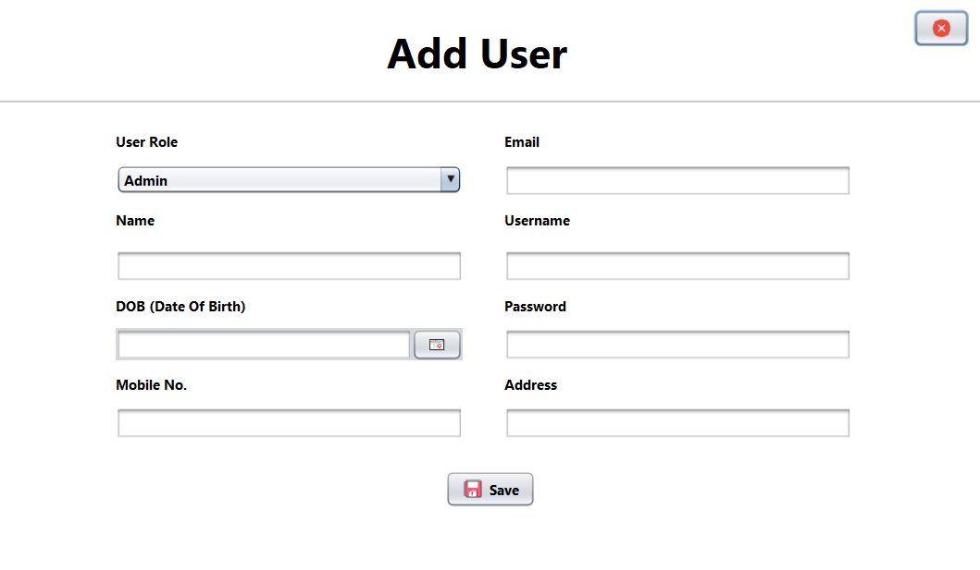
MODULES AND SNAPSHOTS
1. LOGIN
2. DASHBOARD (ADMIN)
The administrator can edit the pharmacists' personal information on this page and add new pharmacists. moreover, he has the option to log out or quit the program.
3. ADD USER
4. PROFILE
5. UPDATE USER
6. VIEW USER
7. DASHBOARD (Pharmacist)
SAMPLE CODE
8. ADD MEDICINE
9. VIEW MEDICINE
10. UPDATE MEDICINE
11. SELL MEDICINE
12. VIEW BILL
OUTCOME OF THE PROJECT
CONCLUSION

Slide 10

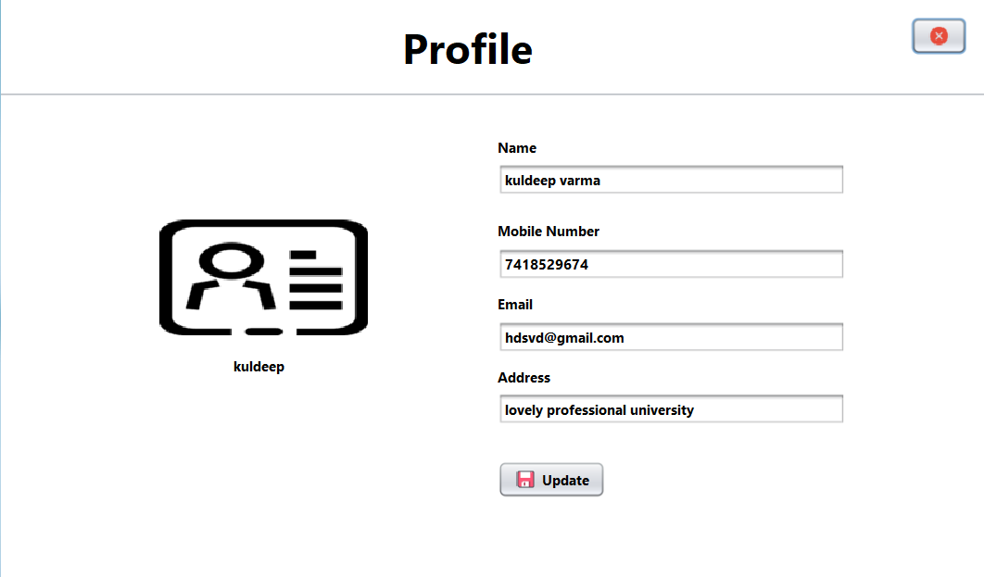
MODULES AND SNAPSHOTS
3. ADD USER
2. DASHBOARD (ADMIN)
The administrator must complete all the necessary boxes on this page in order to add a new chemist. the database will be updated after storing the details, and a pop-up box will confirm that the user has been added successfully.
4. PROFILE
5. UPDATE USER
6. VIEW USER
7. DASHBOARD (Pharmacist)
8. ADD MEDICINE
9. VIEW MEDICINE
10. UPDATE MEDICINE
11. SELL MEDICINE
12. VIEW BILL
SAMPLE CODE
OUTCOME OF THE PROJECT
CONCLUSION

Slide 11
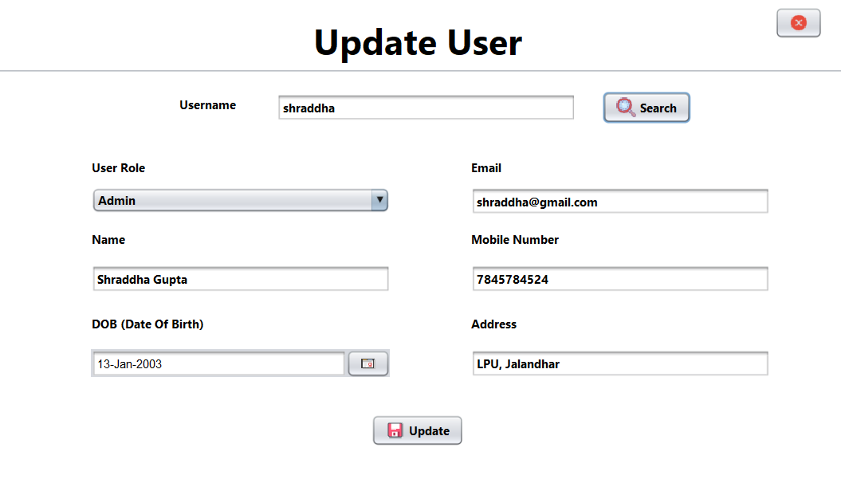
MODULES AND SNAPSHOTS
3. ADD USER
4. PROFILE
In this module, the administrator can alter his profile if he or she is logged in, but the chemist cannot if he or she is logged in. To edit their profile, users must get in touch with the administrator.
5. UPDATE USER
6. VIEW USER
7. DASHBOARD (Pharmacist)
8. ADD MEDICINE
9. VIEW MEDICINE
10. UPDATE MEDICINE
11. SELL MEDICINE
12. VIEW BILL
SAMPLE CODE
OUTCOME OF THE PROJECT
CONCLUSION

Slide 12

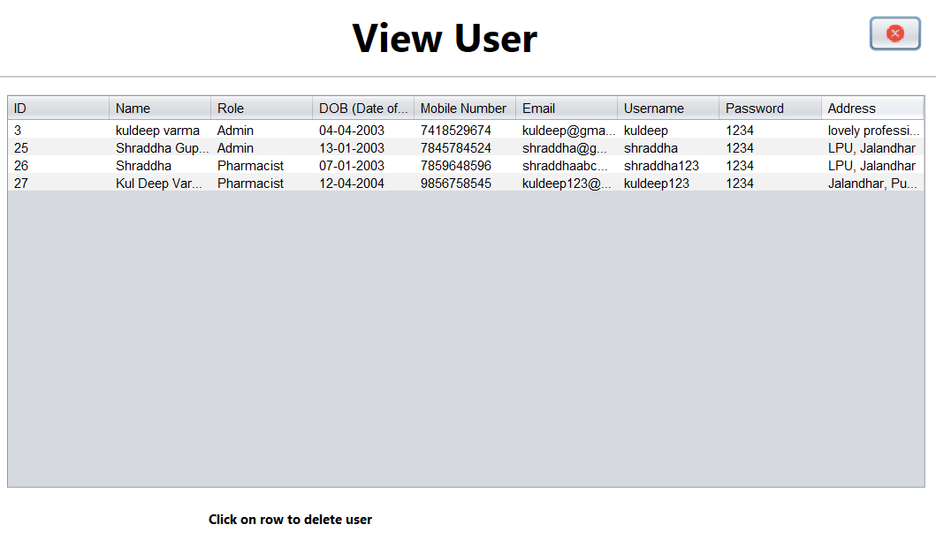
MODULES AND SNAPSHOTS
5. UPDATE USER
The administrator must enter the pharmacist's username and click the search button. Following that, all fields must be completed with the data belonging to that specific user; otherwise, an error pop-up will appear. After making changes, the database administrator can save by selecting update.
6. VIEW USER
7. DASHBOARD (Pharmacist)
8. ADD MEDICINE
9. VIEW MEDICINE
10. UPDATE MEDICINE
11. SELL MEDICINE
12. VIEW BILL
SAMPLE CODE
OUTCOME OF THE PROJECT
CONCLUSION

Slide 13
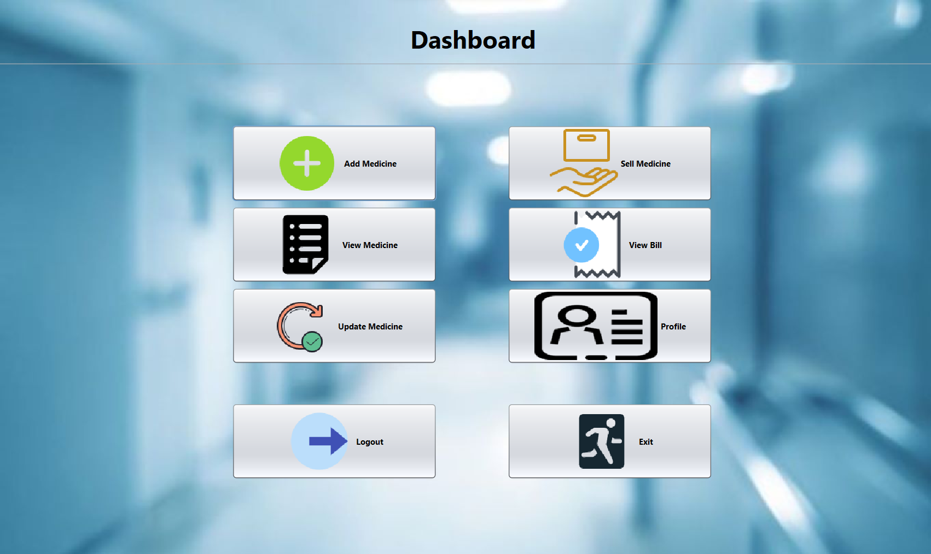
MODULES AND SNAPSHOTS
6. VIEW USER
5. UPDATE USER
In this module the admin can view all the users in the database. By selecting a specific row in this module, admin can delete any user and the same will be updated in database. In order to close this application, you must have to use the button in top-right corner.
7. DASHBOARD (Pharmacist)
8. ADD MEDICINE
9. VIEW MEDICINE
10. UPDATE MEDICINE
11. SELL MEDICINE
12. VIEW BILL
SAMPLE CODE
OUTCOME OF THE PROJECT
CONCLUSION

Slide 14
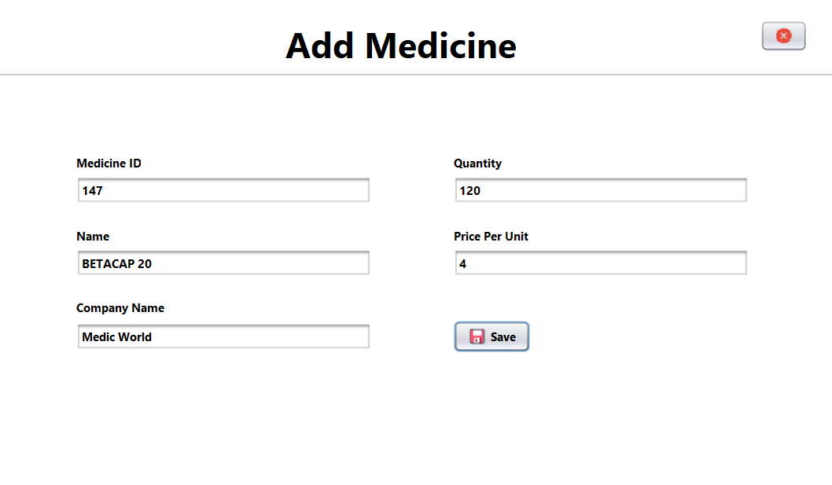
MODULES AND SNAPSHOTS
6. VIEW USER
7. DASHBOARD (Pharmacist)
The chemist can add, view, update, and sell medications in this module. He or she can access their profile, but they must get in touch with the administrator to edit it. They can also view all bills. The chemist must select the appropriate option to log out or quit the application.
8. ADD MEDICINE
9. VIEW MEDICINE
10. UPDATE MEDICINE
11. SELL MEDICINE
12. VIEW BILL
SAMPLE CODE
OUTCOME OF THE PROJECT
CONCLUSION

Slide 15
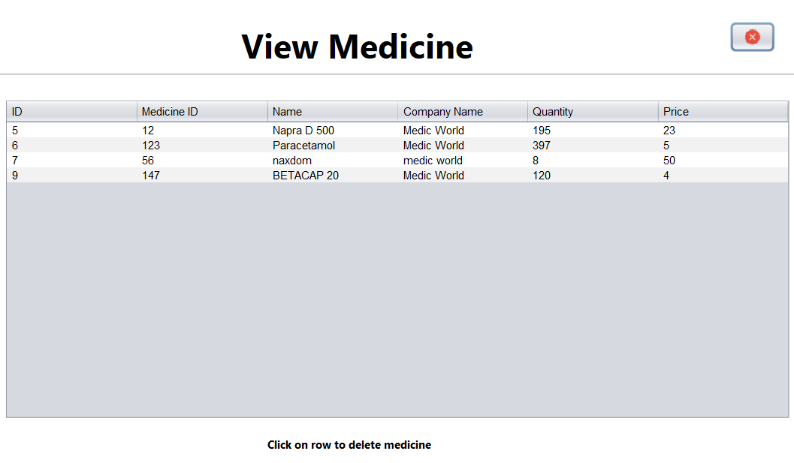
MODULES AND SNAPSHOTS
7. DASHBOARD (Pharmacist)
8. ADD MEDICINE
To add a new medication to the database, the pharmacist must fill out this module with the id, name, company name, quantity, and price per unit of the specific medicament. Any fields that are incomplete or empty will display an error message in a pop-up window.
9. VIEW MEDICINE
10. UPDATE MEDICINE
11. SELL MEDICINE
12. VIEW BILL
SAMPLE CODE
OUTCOME OF THE PROJECT
CONCLUSION

Slide 16

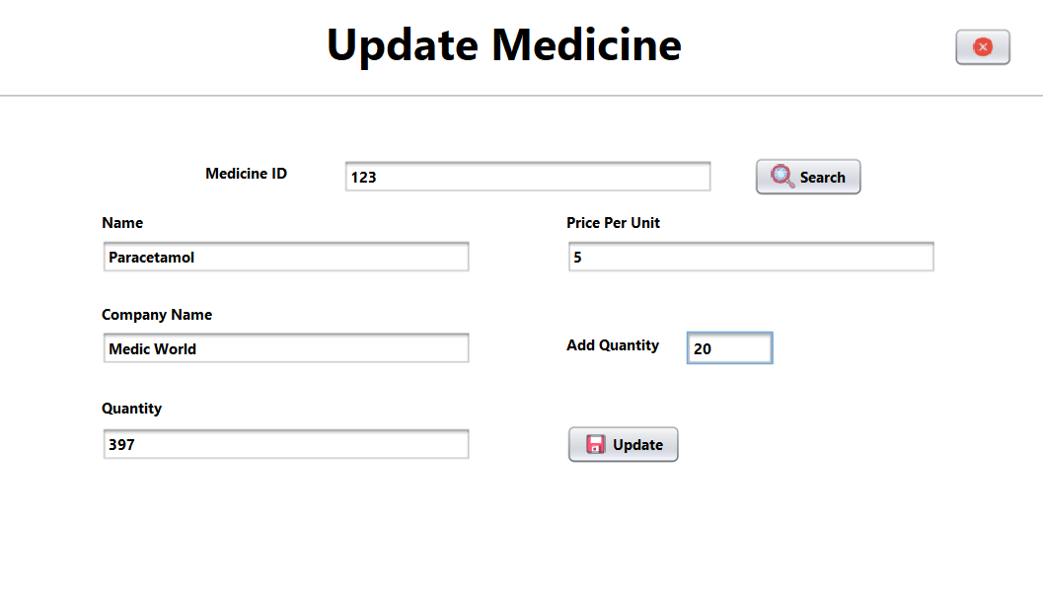
MODULES AND SNAPSHOTS
8. ADD MEDICINE
9. VIEW MEDICINE
The chemist can view all the medications in stock in this module. Any drug can be deleted by a chemist simply clicking on it and confirming the pop-up window.
10. UPDATE MEDICINE
11. SELL MEDICINE
12. VIEW BILL
SAMPLE CODE
OUTCOME OF THE PROJECT
CONCLUSION

Slide 17
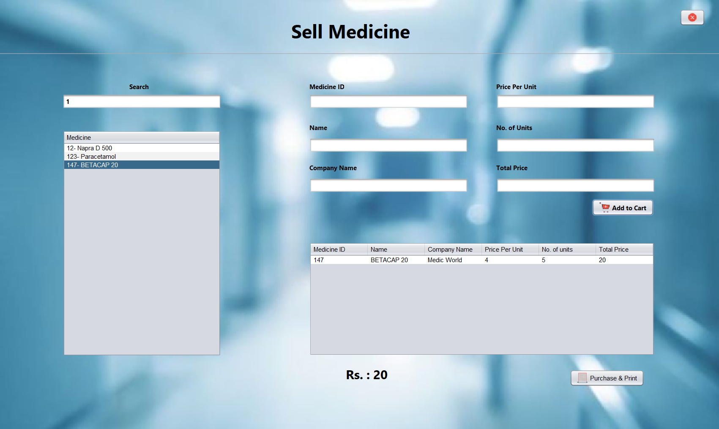
MODULES AND SNAPSHOTS
10. UPDATE MEDICINE
The chemist needs to enter the medicine ID. Except changing the current quantity, the chemist can add more and update all the medication's information by entering all the necessary information and pressing update.
9. VIEW MEDICINE
11. SELL MEDICINE
12. VIEW BILL
SAMPLE CODE
OUTCOME OF THE PROJECT
CONCLUSION

Slide 18

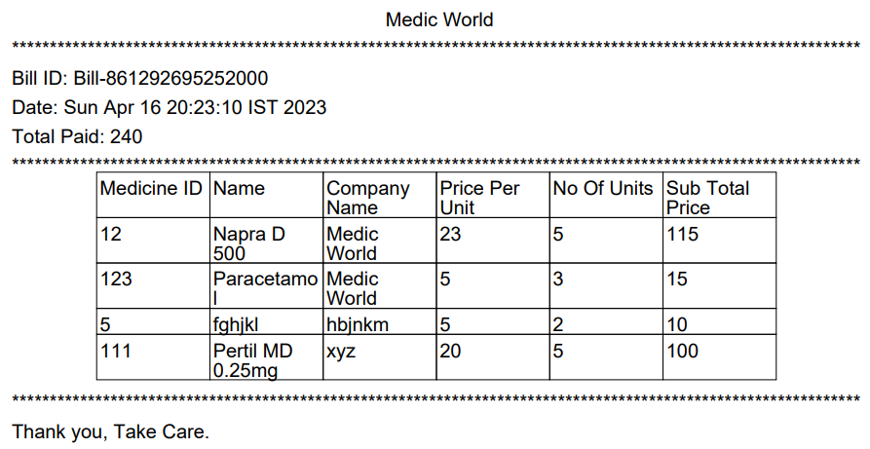
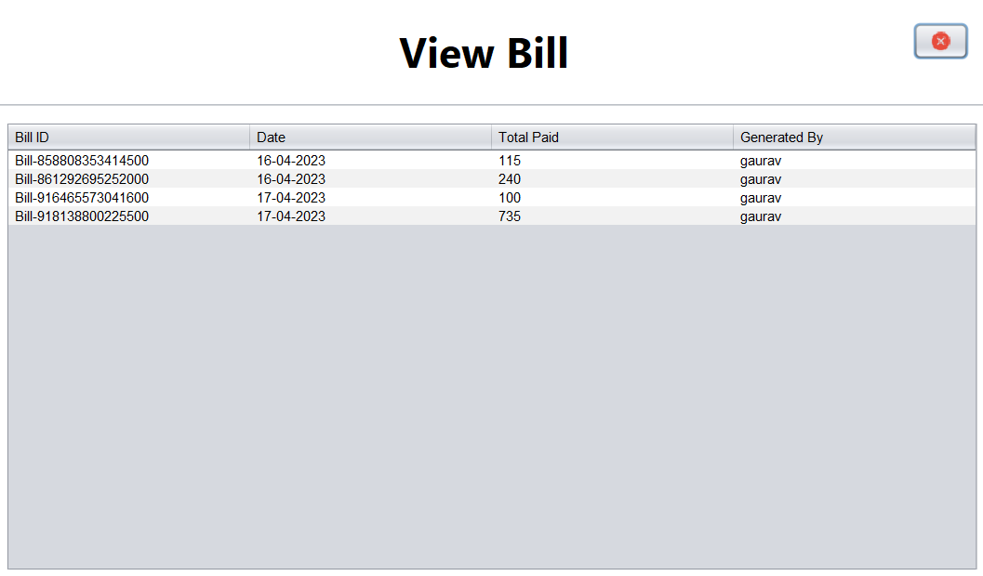
10. UPDATE MEDICINE
MODULES AND SNAPSHOTS
11. SELL MEDICINE
Pharmacists can search for medications by medicine id, and by clicking on a medication, medication's information will be displayed in the relevant fields. After it, he or she should enter quantity before adding to cart. You can remove medicine from your cart by clicking on the row in your cart. The bill can be generated and saved for later use by selecting "purchase and print".
12. VIEW BILL
SAMPLE CODE
OUTCOME OF THE PROJECT
CONCLUSION

Slide 19
MODULES AND SNAPSHOTS
11. SELL MEDICINE
12. VIEW BILL
By selecting a specific row in this module, pharmacists can open any bill pdf. Since they will be used in the future, these bills cannot be removed by application.
Below is the bill format.
SAMPLE CODE
OUTCOME OF THE PROJECT
CONCLUSION

Slide 20
MODULES AND SNAPSHOTS
SAMPLE CODE
12. VIEW BILL
Import javax.swing.*; //library to access all GUI components
Frame – JFrame framename=new JFrame();
Framename.setSize(1366,763); //frame dimentations
Button – JButton buttonname=new JButton("name"); //name - that should be displayed on button
Text field – JTextField textfieldname= new JTextField("content");
abc
OUTCOME OF THE PROJECT
CONCLUSION

Slide 21
SAMPLE CODE
OUTCOME OF THE PROJECT
Import javax.swing.*; //library to access all GUI components
Frame – JFrame framename=new JFrame();
Framename.setSize(1366,763); //frame dimentations
Button – JButton buttonname=new JButton("name"); //name - that should be displayed on button
Text field – JTextField textfieldname= new JTextField("content");
This project investigates the design and implementation of a pharmaceutical administration system. This is done by creating a database of the drugs that are bought and sold at the shop. The primary objective of the pharmacy management system is to increase accuracy while also boosting the efficiency and security of the business. The objective of this project is to develop software for effective retail administration.
CONCLUSION

Slide 22

OUTCOME OF THE PROJECT
CONCLUSION
abc
According to the system type, we have a project in this case that is on a computer. This will assist you in enhancing the cost, insurance, security, and other aspects of the administration of a medication. A pharmacy management system has been developed to ensure consumer dependability. They will be able to sell access to drugs as well as the right to use them, which will lessen the prevalence of these illicit operations. Statistics medications, drugs, or medications to regulate the data that may also be updated and modified. The user is responsible for carrying out the manufacture, sale, and purchase transactions if the medical product is not available. This software can also print receipts. You get access to a wide range of additional features. Its primary objective is to maintain and facilitate the effective management of pharmacy data
THANK YOU

Slide 23
According to the system type, we have a project in this case that is on a computer. This will assist you in enhancing the cost, insurance, security, and other aspects of the administration of a medication. A pharmacy management system has been developed to ensure consumer dependability. They will be able to sell access to drugs as well as the right to use them, which will lessen the prevalence of these illicit operations. Statistics medications, drugs, or medications to regulate the data that may also be updated and modified. The user is responsible for carrying out the manufacture, sale, and purchase transactions if the medical product is not available. This software can also print receipts. You get access to a wide range of additional features. Its primary objective is to maintain and facilitate the effective management of pharmacy data
CONCLUSION
THANK YOU

